Slide 1


SQL & POWER BI
CAPSTONE PROJECT
ÖZGE BOZKURT GÖCMEN

Slide 2



1
ABOUT ME
OUTLINE
2
SQL QUERIES
3
POWER BI GRAPHICS
4
UPSCHOOL JOURNEY

Slide 3




ABOUT ME
ISTANBUL
UNIVERSITY
MET. AND MAT.
ENG.
UPSCHOOL
JOURNEY
1995 2013 2017 2018 2024
BORN
IN ISTANBUL
CAREER
STARTING
GRATUATION

Slide 4








ER DIAGRAM OF AUTOMOTIVE BUSINESS DATA SET
EMPLOYEE
CATEGORY
PRODUCT
STORE
ORDERS
PROVIDER
CUSTOMER

Slide 5


SQL QUERIES

Slide 6



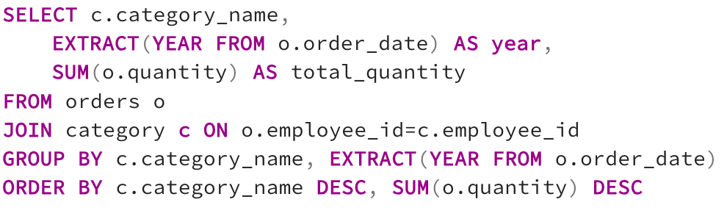
TOTAL QUANTITY IN YEARS BY CATEGORY

Slide 7
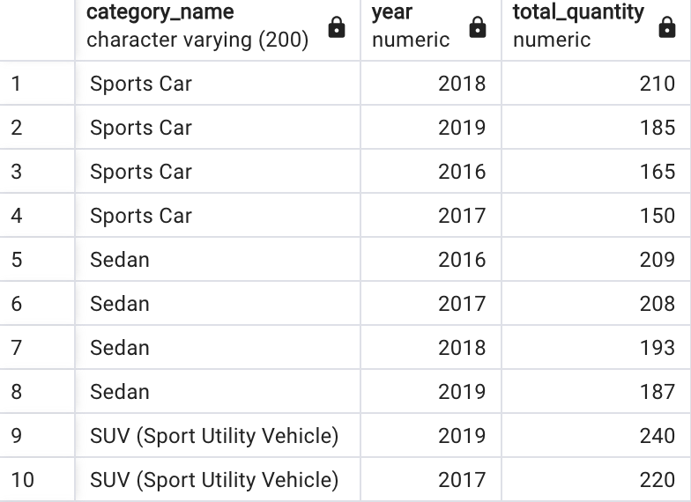
TOTAL QUANTITY IN YEARS BY CATEGORY

Slide 8
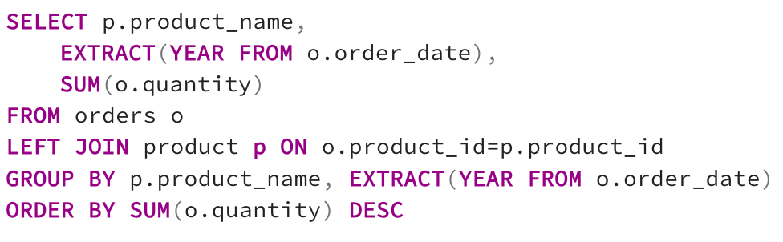
TOTAL QUANTITY IN YEARS BY BRANDS

Slide 9
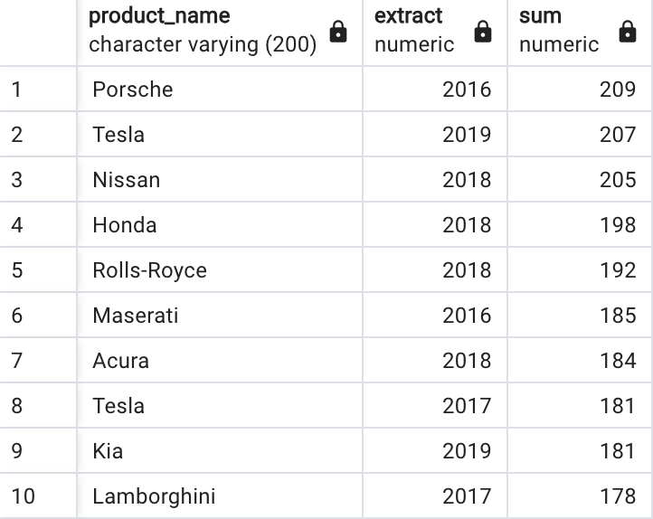
TOTAL QUANTITY IN YEARS BY BRANDS

Slide 10
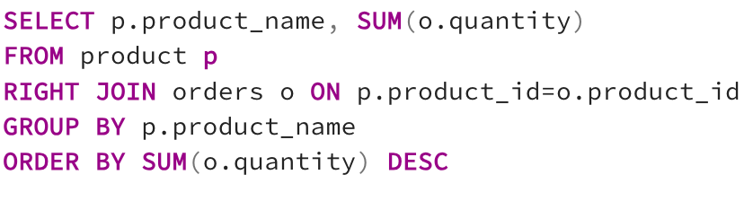
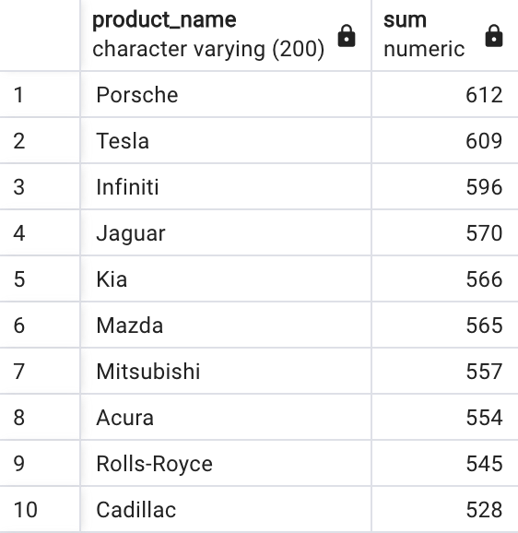
TOTAL QUANTITY BY BRANDS

Slide 11
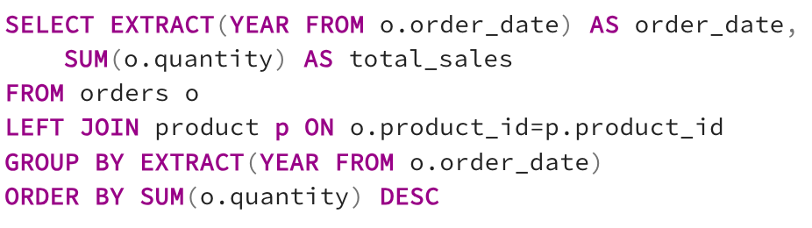
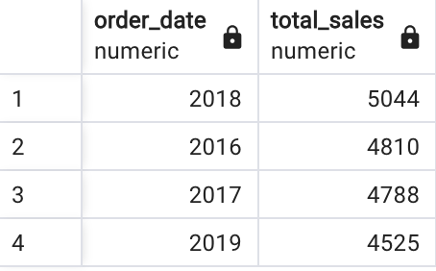
TOTAL QUANTITY BY YEARS

Slide 12
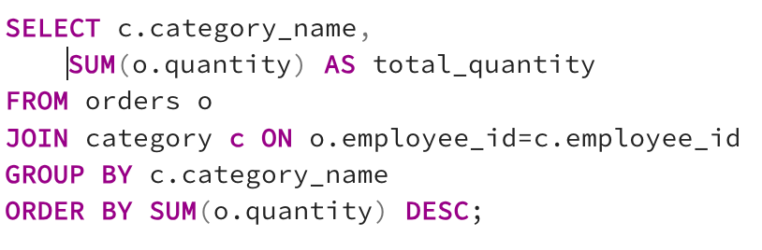
TOTAL QUANTITY BY CATEGORIES

Slide 13
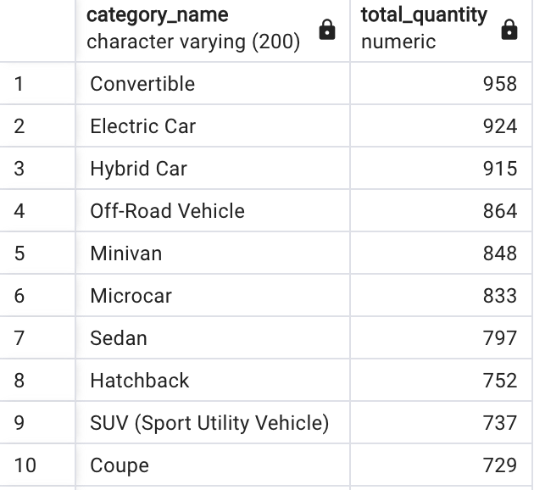
TOTAL QUANTITY BY CATEGORIES

Slide 14
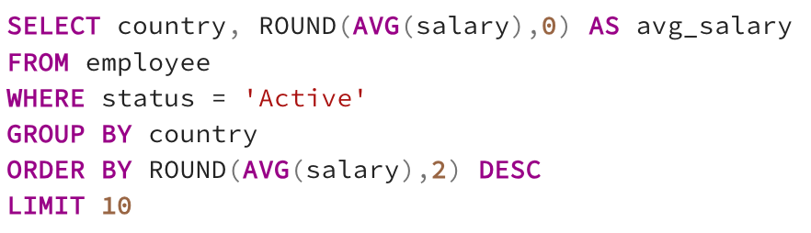
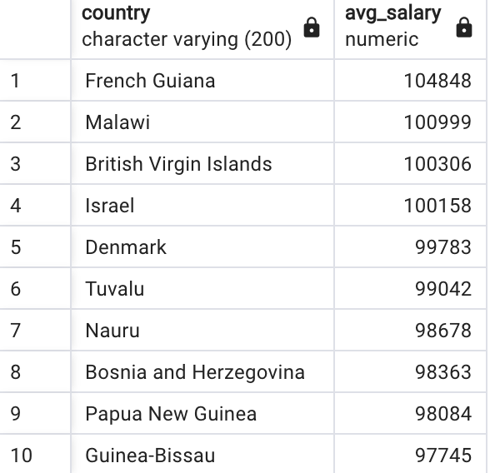
AVERAGE SALARIES OF TOP 10 ACTIVE EMPLOYEES BY COUNTRY

Slide 15
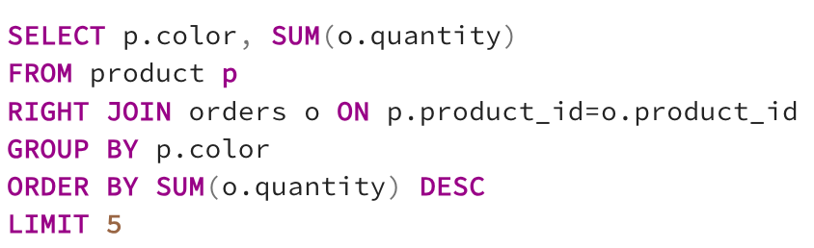
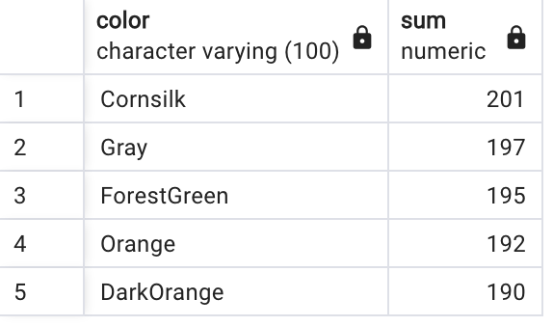
5 TOP PREFERRED COLORS

Slide 16
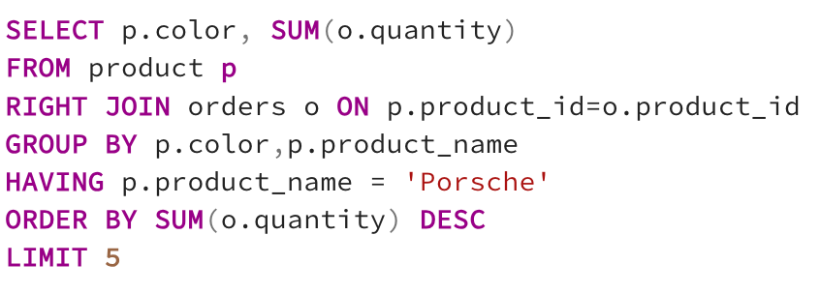
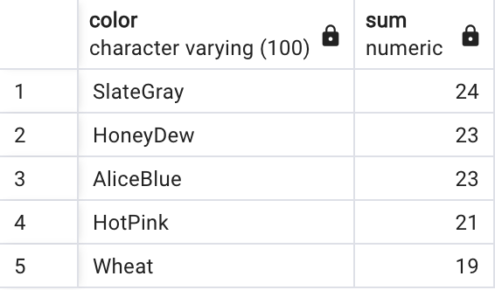
5 TOP PREFERRED COLORS IN PORSCHE

Slide 17
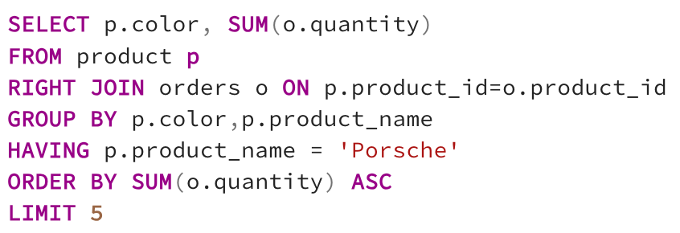
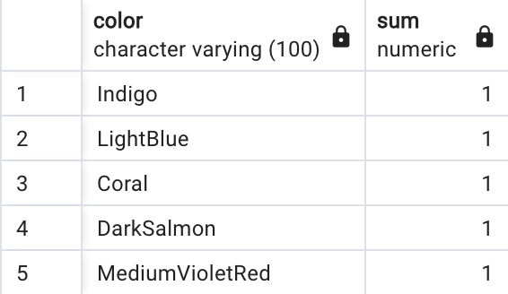
5 LEAST PREFERRED COLORS IN PORSCHE

Slide 18
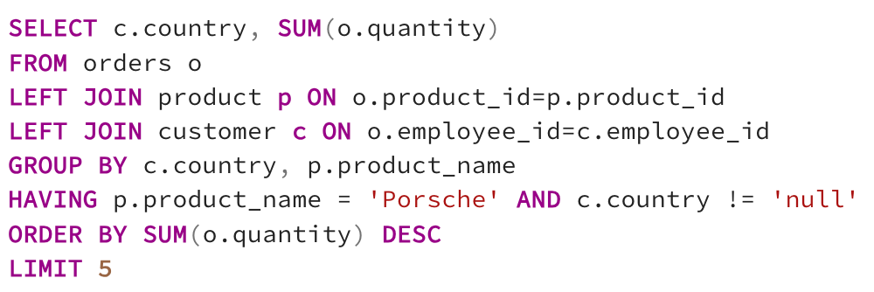
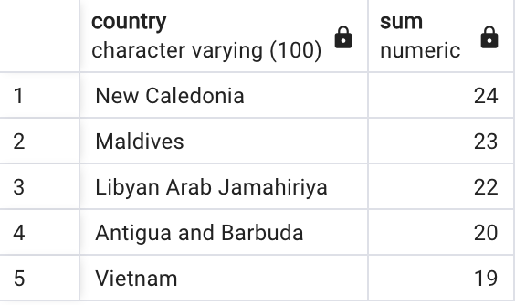
TOP 5 COUNTRIES WITH THE MOST PORSCHE CONSUMERS

Slide 19
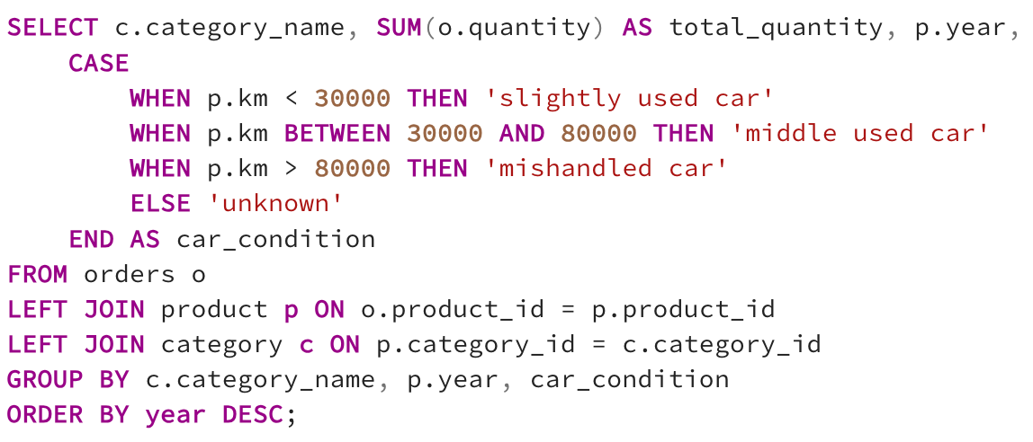
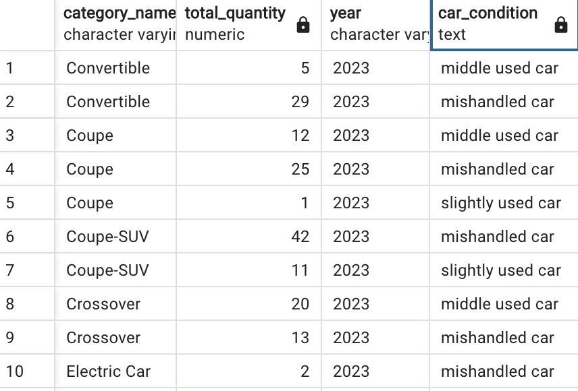
USAGE STATUS OF THE PRODUCTS OFFERED FOR SALE ACCORDING TO VEHICLE YEAR AND CATEGORY TYPE

Slide 20
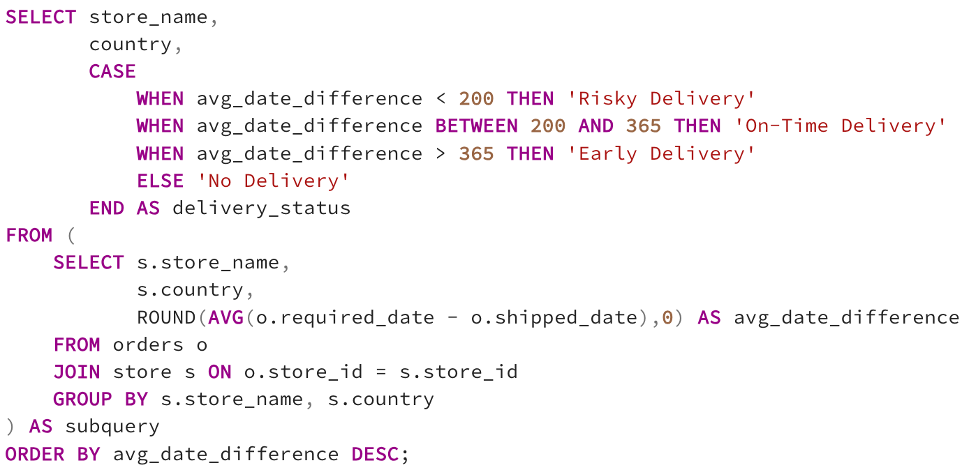
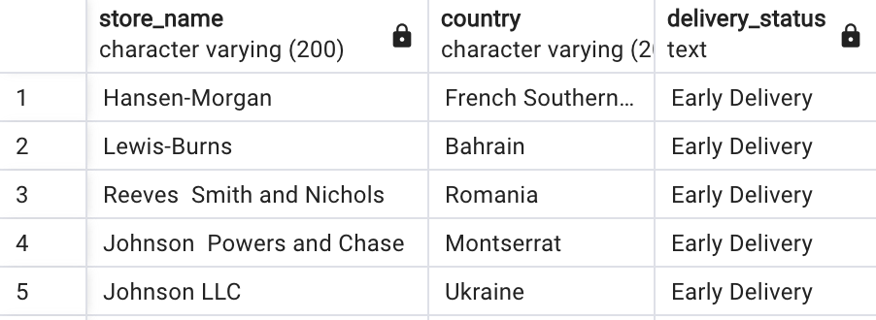
DELIVERY STATUS OF PRODUCTS BY STORES

Slide 21
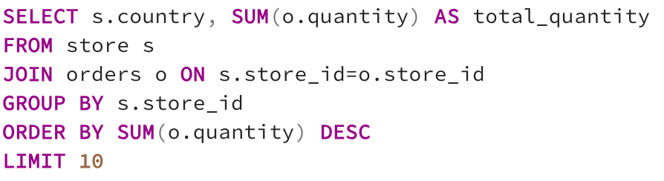
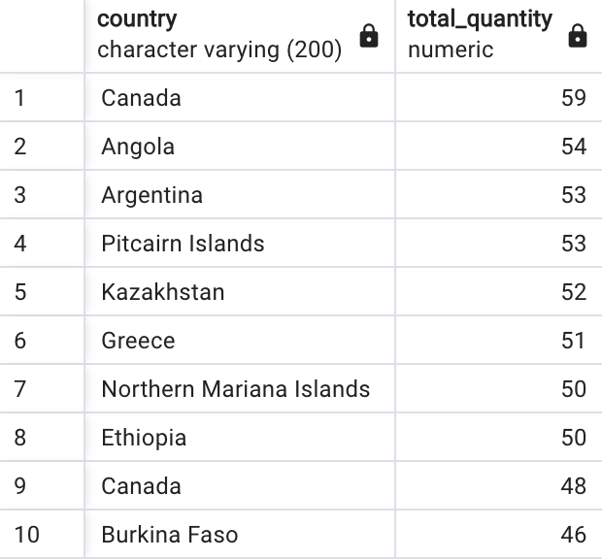
THE QUANTITY OF TOP 10 PROVIDERS

Slide 22
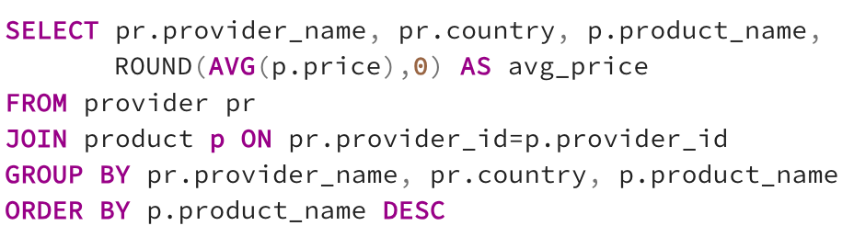
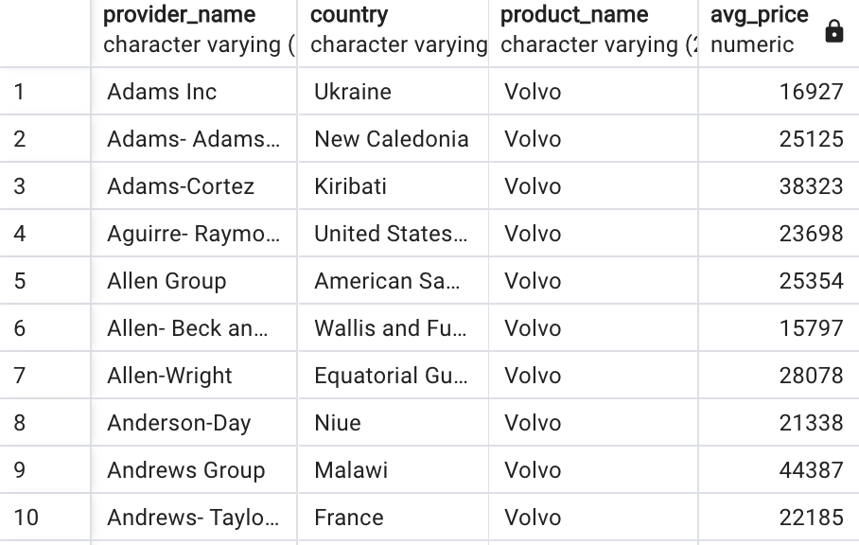
BRANDS AND AVERAGE PRICES BY PROVIDERS

Slide 23
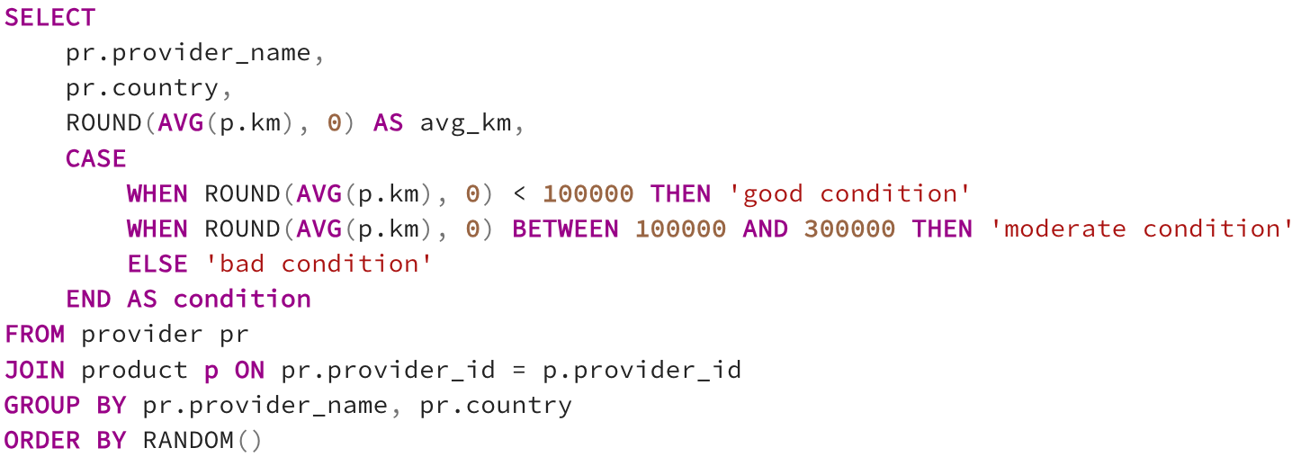
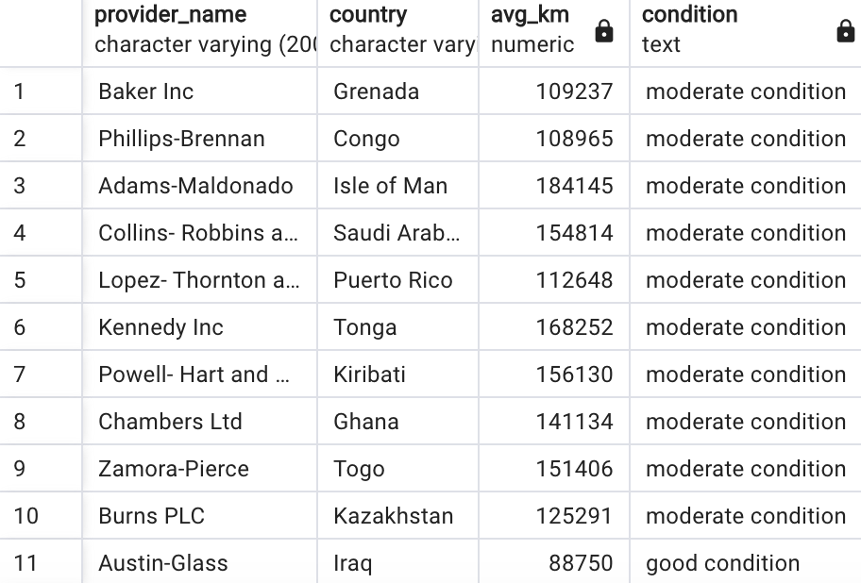
AVERAGE KM OF PRODUCTS BY PROVIDERS

Slide 24
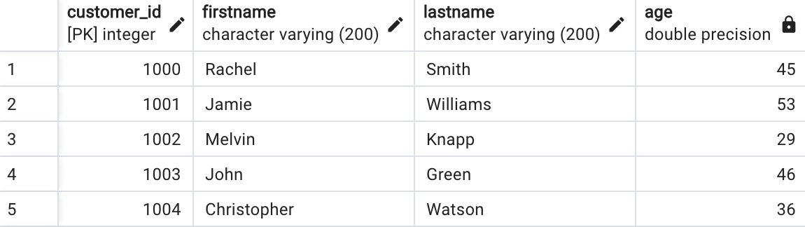
THE AGE OF CUSTOMERS

Slide 25
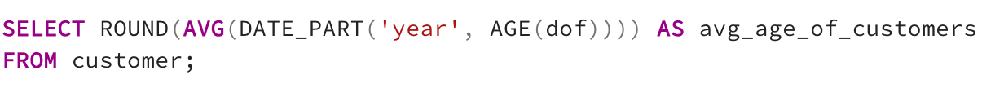
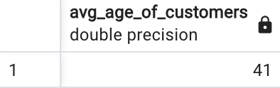
THE AVERAGE AGE OF CUSTOMERS

Slide 26
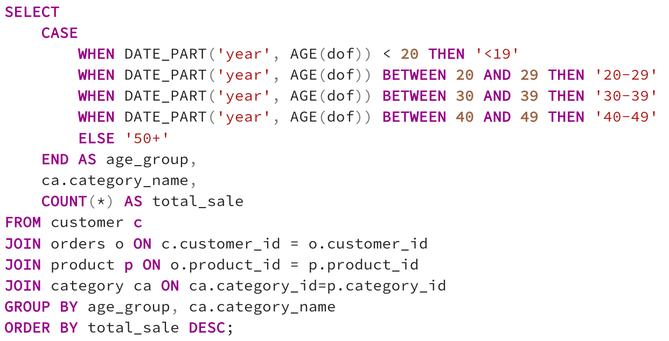
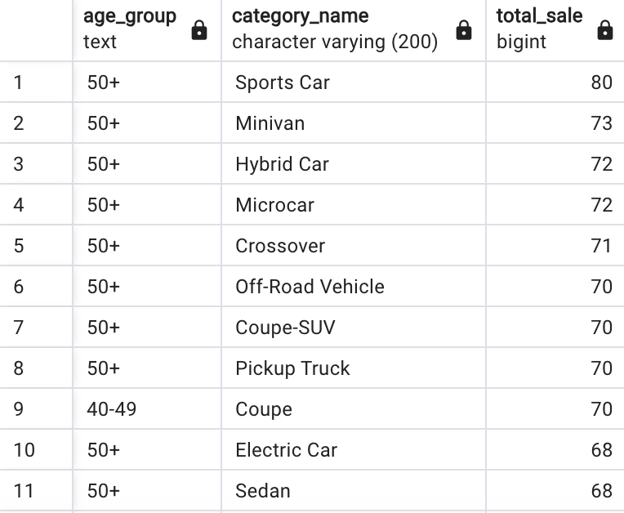
THE PREFERRED CATEGORIES BY CUSTOMERS ACCORDING TO THEIR AGE RANGE

Slide 27
POWER BI GRAPHICS

Slide 28
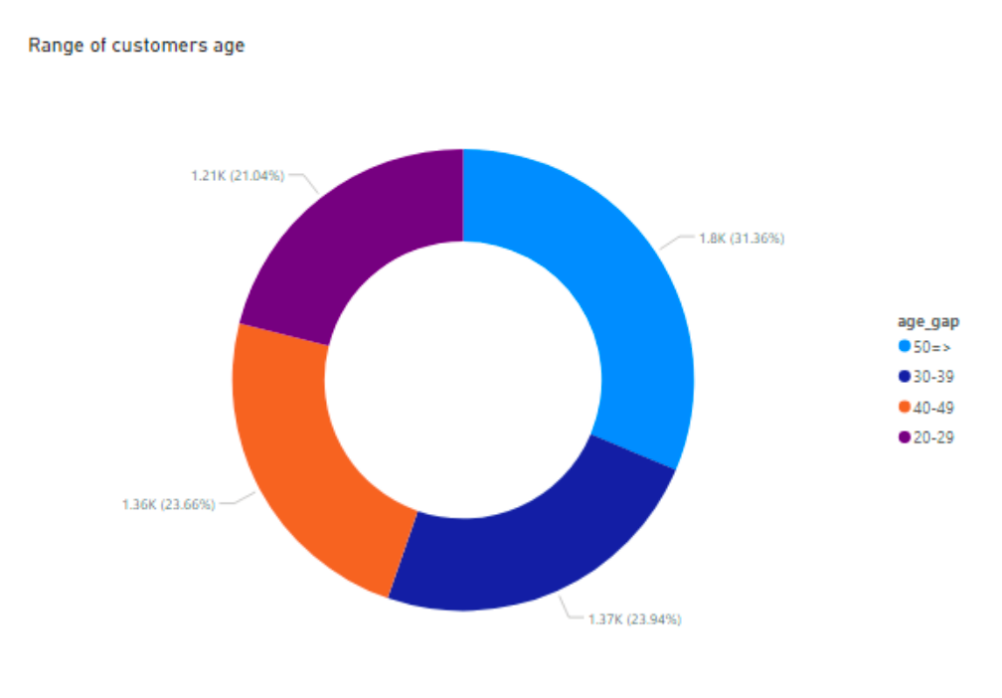
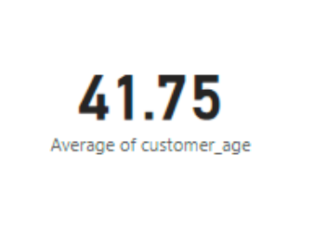
AVERAGE AGE AND AGE RANGE OF CUSTOMERS

Slide 29
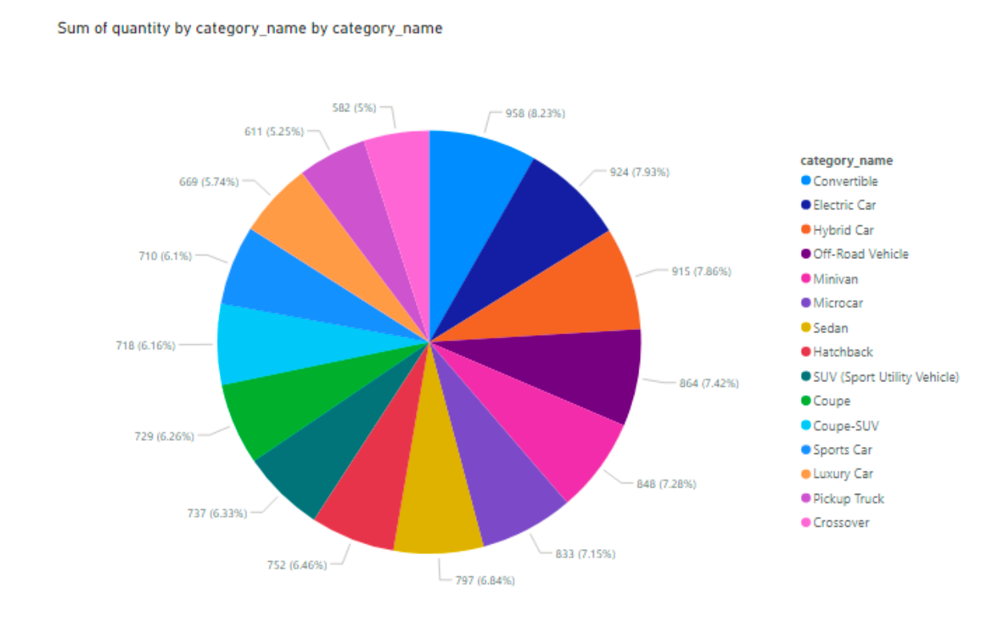
SUM OF QUANTITY BY CATEGORY NAME

Slide 30
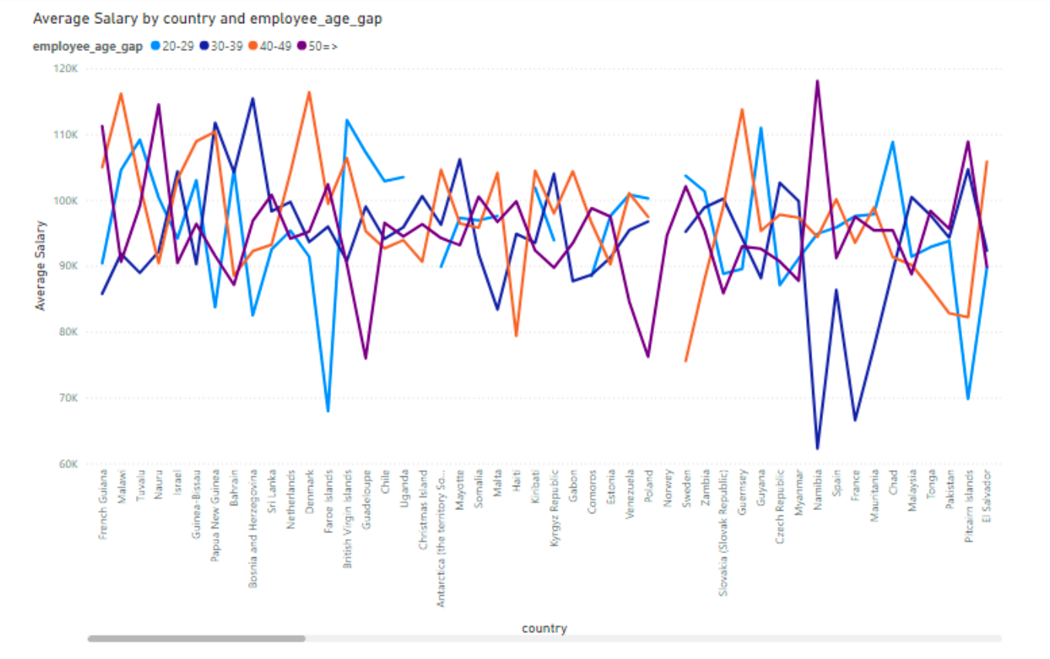
AVERAGE SALARY BY COUNTRIES AND EMPLOYEE AGE GAPS

Slide 31
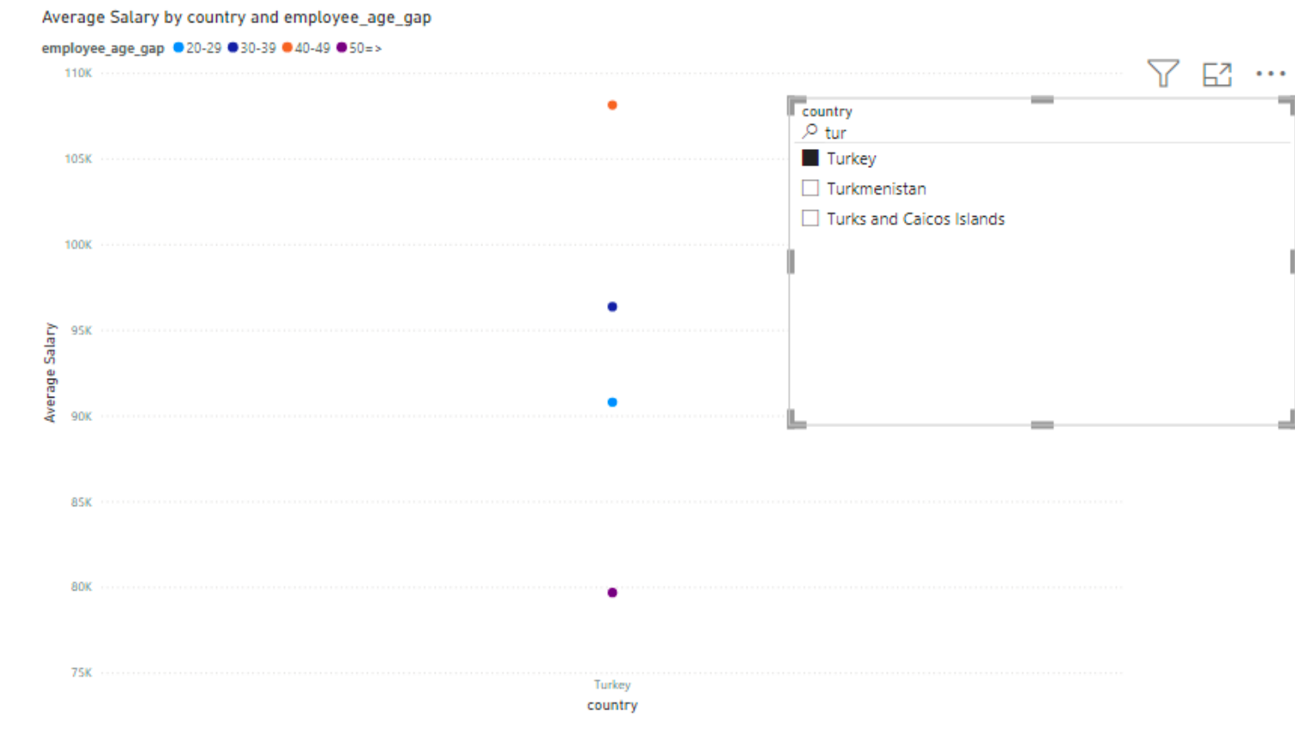
AVERAGE SALARY BY EMPLOYEE AGE GAPS IN TURKEY

Slide 32
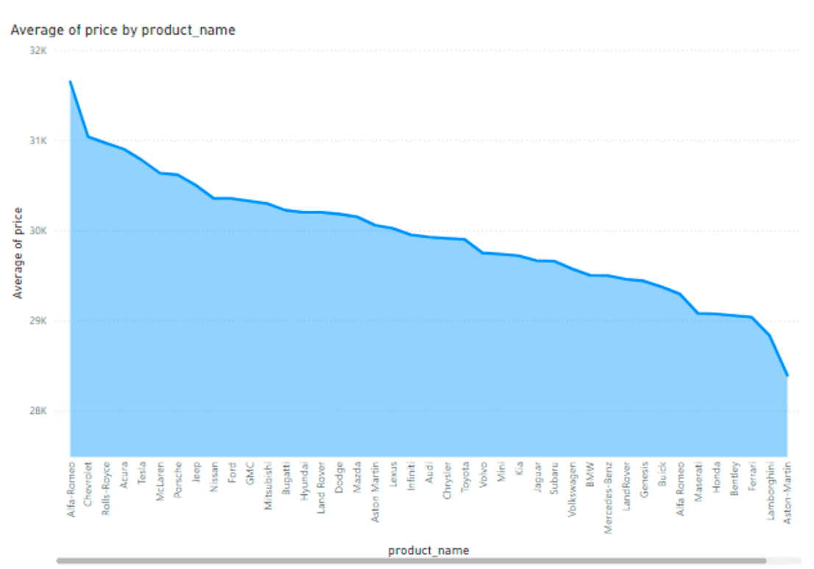

AVERAGE PRICE OF BRANDS BY YEARS

Slide 33



UP SCHOOL
JOURNEY
MOTIVATION
FEED
FORWARD
SISTERHOOD

Slide 34


Thank you!

